Slide 1
Module 1:
Introduction To System Design
Sanket Singh SWE 2 @ Google

Slide 2
What will you learn
Stateless systems
Stateful systems

Slide 3
Handling stateless Request

Slide 4
What is a stateless request ?
A "stateless request" in this context refers to an interaction that doesn't rely on or change any saved state of the system.
This means that each request from a client to a server contains all the information needed for the server to understand and process the request. The server does not store any context between requests. Every request is treated as an isolated and independent transaction.
In cases of stateless request the app server layer is called as a stateless layer.
Notes:
**Stateless RESTful API: Weather Information Service**
**Service Description**:
Imagine an online service that provides current weather information based on a city name.
**Stateless Interaction**:
1. **Request**:
- A client application wants to know the current weather for New York.
- The client sends an HTTP GET request to the weather service's endpoint, like: `GET /weather?city=NewYork`
2. **Transaction Details**:
- The request URL contains all the necessary information (`city=NewYork`) for the weather service to understand and process the request.
- The service doesn't need to remember any previous requests from this client. It doesn't matter if this is the client's first request or the hundredth.
3. **Server Processing**:
- The server processes this request independently of any other requests.
- It looks up the current weather for New York, prepares the data, and sends it back in the response.
4. **Response**:
- The server returns the weather data for New York in the response, for example:
```json
{
"city": "New York",
"temperature": "22°C",
"condition": "Sunny"
}
```
5. **Next Request**:
- Later, the client wants to know the weather for Los Angeles.
- The client sends another HTTP GET request: `GET /weather?city=LosAngeles`
- Again, the server processes this as an entirely new and independent request. It doesn't "remember" that the client asked about New York earlier.
**Technical Note**:
While the interaction with the RESTful API is stateless, the server might still access a database or another stateful system behind the scenes to fetch the actual weather data. However, from the client's perspective and in terms of the client-server interaction, the process is stateless.
This stateless nature allows the weather service to easily handle requests from millions of users concurrently without maintaining a session or state for each user, providing scalability and simplicity in design.

Slide 5
How LB treats stateless request?
We can observe that for stateless requests there is no extra work that LB has to do, as any of the healthy app servers can entertain the incoming request.
This is because a single app server is able to handle any incoming request.

Slide 6
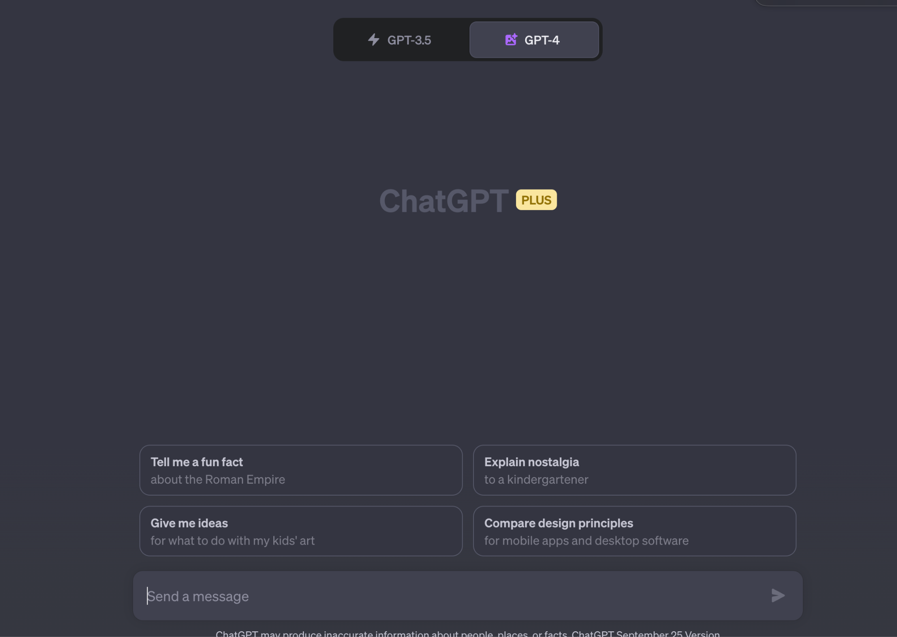
Let’s take an example of chatgpt
In case of ChatGPT, every running conversation is dependent on the context i.e. after 4-5 messages whatever message we share should have context about previous 4-5 messages.
Notes:
Now let’s say we store the context data in the app server which first received the request, then if any later incoming set of req comes to a diff app server then that app server won’t be able to answer the req properly as it doesn’t have the required context. This usecase makes the job of a lb a bit hard as in this statefull app where state is maintained in the app server the lb has to calculate which app sevrer will be the best one to handle the incoming req.

Slide 7
What is the main problem?
Due to the existence of the state inside the app server lb has to do extra work.

Slide 8
How about we separate the state outside of an app server into a DB layer?

Slide 9
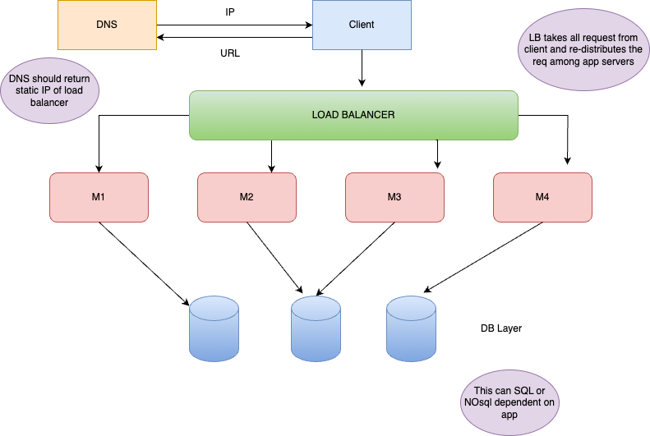

Slide 10
Isn’t this a bit inefficient ?
There will be a separate network call to the DB server.
We might need locks or index step in the DB.
We load the request in the app server memory forward it to DB, get the response back from the DB to app server’s memory and then from the response send it back to the client.

Slide 11

How about instead of just using a DB layer we introduce a layer of persistent cache also?

Slide 12
What is persistent cache ?
General cache are volatile in nature.
Persistent cache on the other hand uses diff techniques to store data and make it available later also.
Example: Redis, memcache
Redis is a in-memory cache but it creates backup data in the disk to recover data again when memory wipe happens.

Slide 13
Problems with cache layer
We can’t also replace DB Layer with cache as they can’t store too much data but if we introduce them then that improves the performance.
Here because we might keep a global cache, there will be still a network call.
Although other db overheads will be avoided.

Slide 14
So do we never need stateful system ?

Slide 15
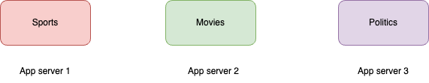
There are cases where having stateful systems are a better choice…
Say we want to make an ad platform where based on user interaction we want to show similar ads based on what user is currently seeing and not based on history.
App focus more on what user is seeing that who the user is..
Notes:
For this kind of a system we need some online query based models which will change the tuning parameters on the go when multiple users look at similar topic

Slide 16
Where should we keep these ML Models?
We will keep the model files in the app server only. Because if we detach the models from app servers then loading them in memory again and again is expensive task. Additional overhead like I/O and network calls are involved.

Slide 17
Who will route the incoming request to the right app server ?
Load balancers will be responsible as well. LB will use page type as a key for balancing.

Slide 18
What if the app later focus more on who user is?
Then we decide some other LB key like user_id for load balancing. But still keep the system stateful due to previous problems with ML Models.

Slide 19
Recap
A stateless system does not retain user session information between requests
A stateful system remembers and maintains user session data over interactions

